Slide 1
Lecture 2-1
Md. Saddam Hossain

Slide 2
Neuron Model
McCullogh-Pitts Model
Perceptron Model
ADLINE

Slide 3
Perceptron Neuron Model
Outputs from a set of sensory units are fed to a fixed set of association units
    Association units performs predetermined manipulation
Weights are adjustable (Main difference with the McCullogh-Pitts Model )
Learning rule is provided for adjusting weights

Slide 4
Linear Classifier

Slide 5
Linear discriminant functions and decisions surfaces
Definition
  It is a function that is a linear combination of the components of x
  g(x) = w^{t}x + w₀ (1)
  where w is the weight vector and w₀ the bias
A two-category classifier with a discriminant function of the form (1) uses the following rule:
Decide ω₁ if g(x) > 0 and ω₂ if g(x) < 0
⇔ Decide ω₁ if w^{t}x > -w₀ and ω₂ otherwise
If g(x) = 0 ⇒ x is assigned to either class

Slide 6
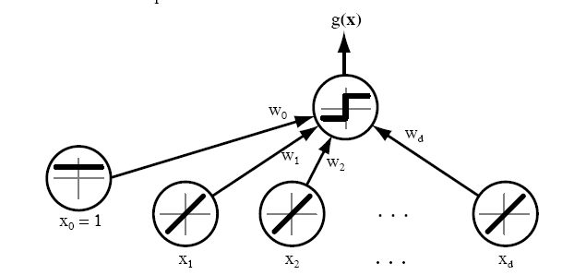
Linear discriminant functions and decisions surfaces

Slide 7
  The equation g(x) = 0 defines the decision surface that separates points assigned to the category ω₁ from points assigned to the category ω₂
  When g(x) is linear, the decision surface is a hyperplane
  Algebraic measure of the distance from x to the hyperplane (interesting result!)

Slide 8
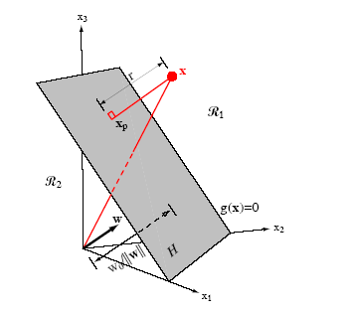

Slide 9
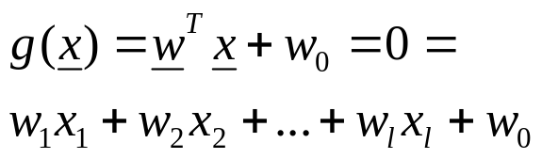
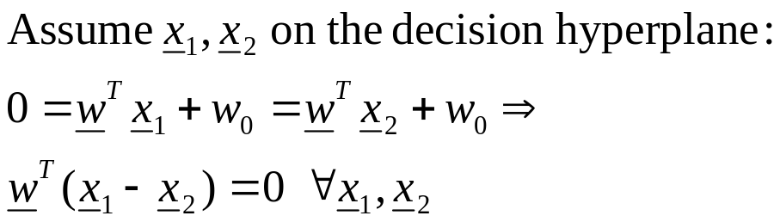
A little bit mathematics
The Problem: Consider a two class task with ω₁, ω₂

Slide 10

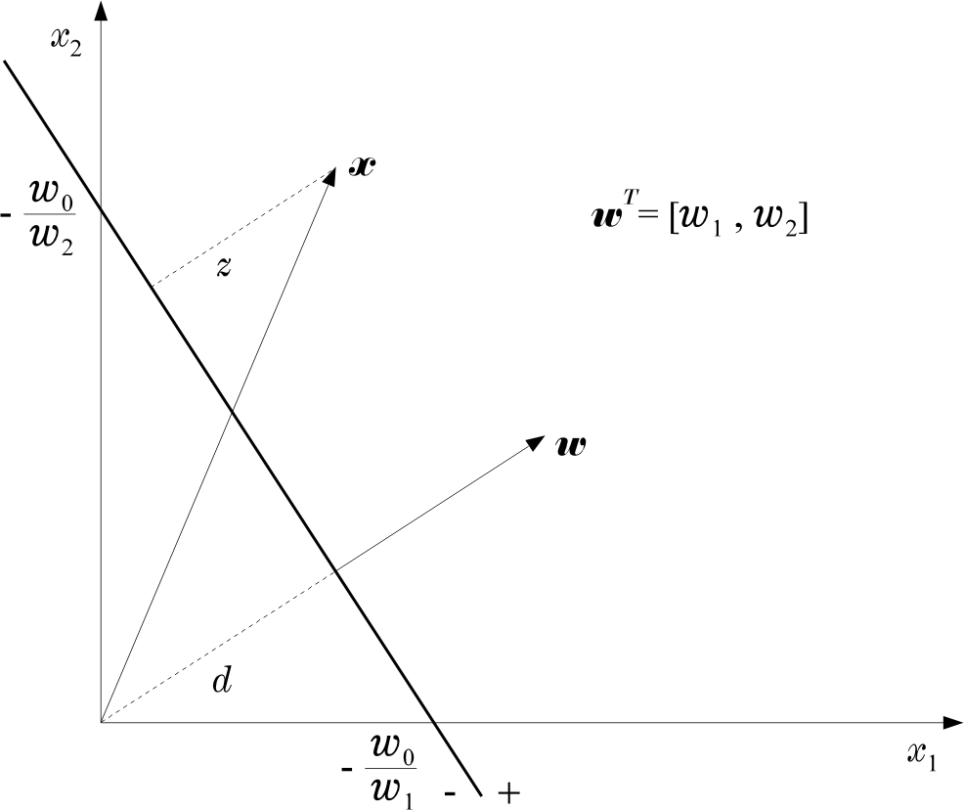
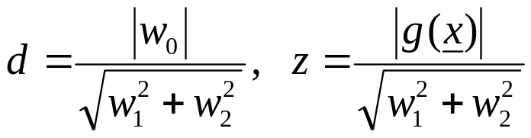
  Hence:

